Slide 1
BREACH AND ATTACK SIMULATION SERVICE
MSS-BAS
SERGIO HEKER

Slide 2
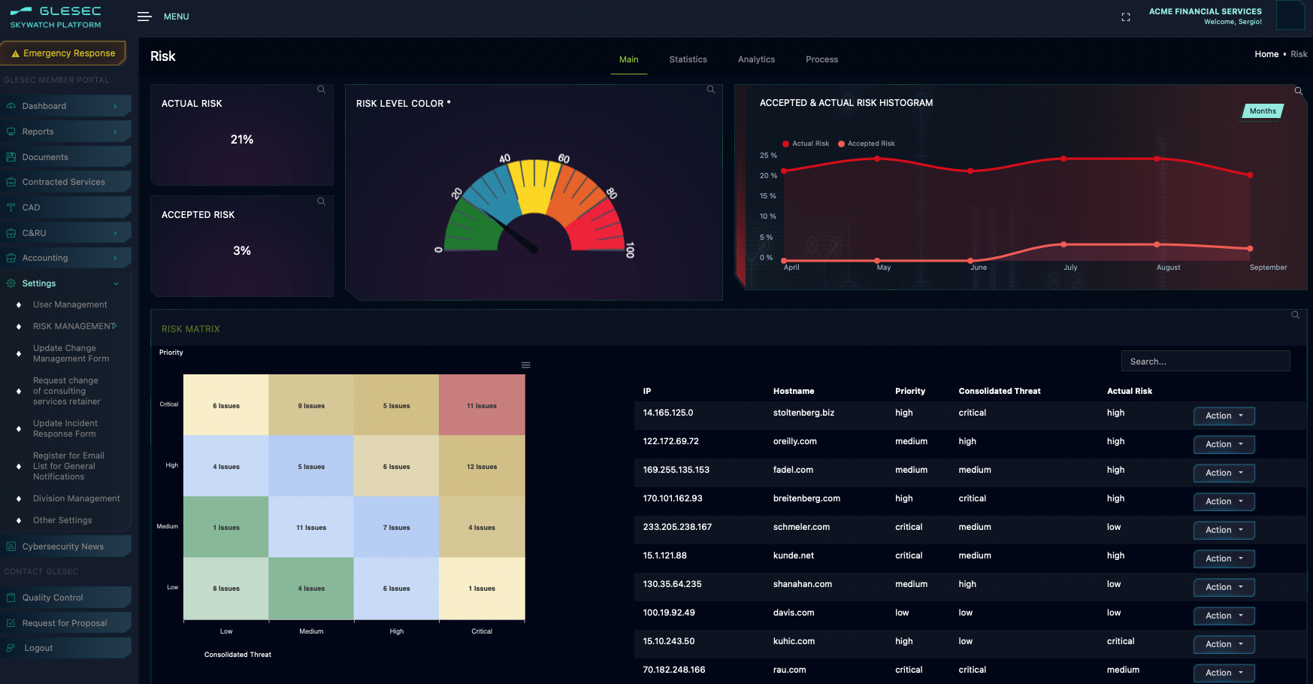
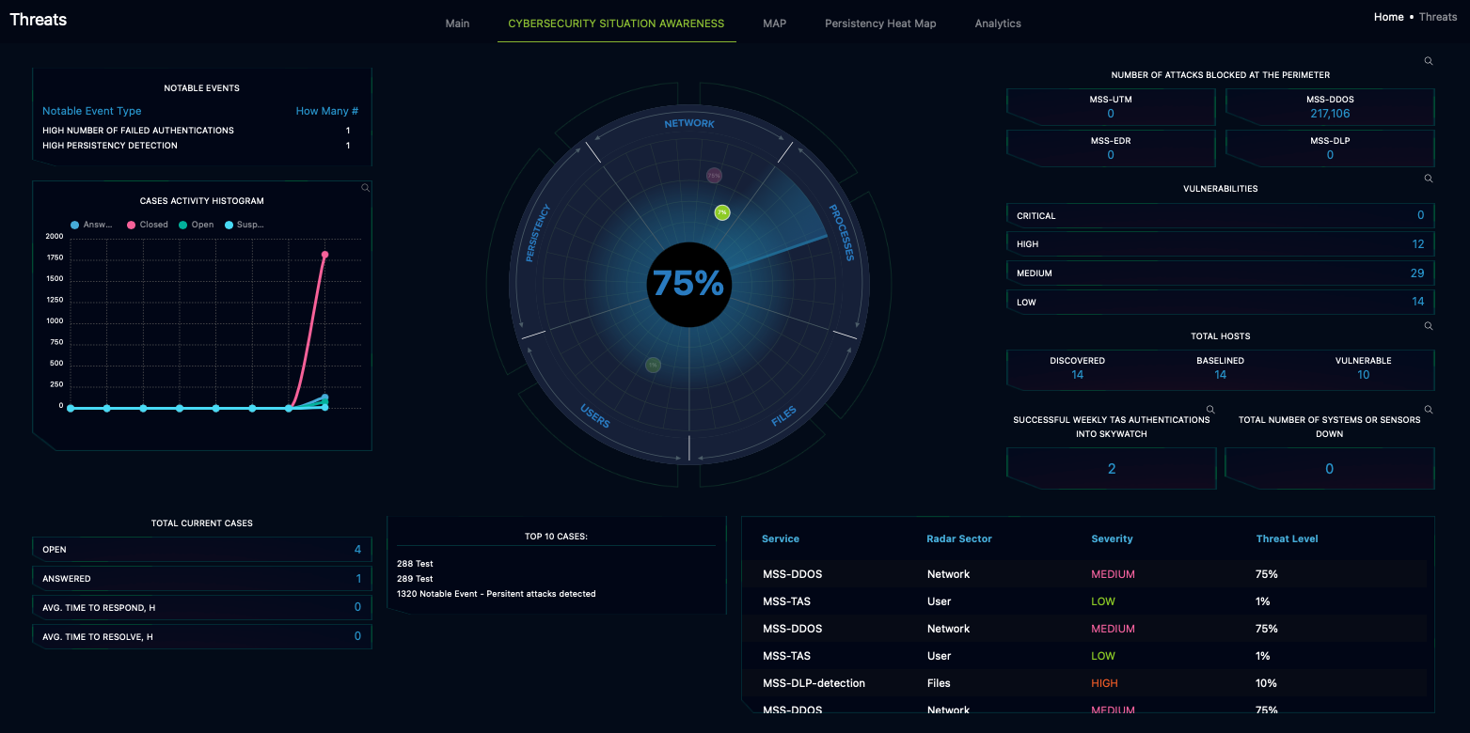
Where RISK Management meets Cybersecurity
Notes:
GLESEC’s SKYWATCH Platform and Portfolio of services are by-design comprehensive (complete and integrated) and created to be a RISK Management Platform, Cybersecurity Platform and a Compliance Platform. All operating in (quasi) real-time and to facilitate an organization the inter-departmental and multi-layer information flow and business optimization.

Slide 3
1
2
3
4
Challenge
What is this service?
How does it work?
Benefits
Notes:
This documents the service in its entirety. The content of this document is COMPANY CONFIDENTIAL. Some of it will be used for various purposes (after approval) such as marketing or creating other documents for operations. The main intent is to concentrate all information for the service and to be used as the content for internal training (mandatory for all technical areas) of GLESEC.
In this presentation you will learn about this service, what is the challenge that it addresses, how does it work and what are the benefits.
The audience for this document is prospective clients, existing clients, technical personnel of GLESEC for which this training is required and other members of the GLESEC staff that have desired to learn.

Slide 4
Challenges
Many organizations are not aware of the effectiveness of their security controls.
Lack of cybersecurity visibility and operational metrics and translation between technical and executive
Lack of Skilled and 7x24 cybersecurity personnel
No real-time and comprehensive alignment to standards for compliance or best-practice
Effectiveness of inter-department communication
When there is a detection of a gap in the security controls, organizations tend to manage this as a project
It usually takes a significant amount of time to remediate vulnerabilities
Notes:
If we divide the components of the description of what this service is, we will have the following components:
Service operates around the clock, 7x24x365
It is for the protection against denial-of-service attacks, intruder attacks, scanning and other type of perimeter level attacks. It protects the firewall of the organization.
The capability of the service is to: detect and respond.
The service is also used in a preventative manner to identify and reduce persistent attacks.

Slide 5
What is it?
The Managed Breach & Attack Simulation Service is a lifecycle process-based testing service to validate the effectiveness of the security countermeasures across the full attack-chain and to reduce the time of gap remediation.
The service provides critical information for the determination and RISK as part of the SKYWATCH Suite of services and the SKYWATCH Platform.
Notes:
If we divide the components of the description of what this service is, we will have the following components:
Service operates around the clock, 7x24x365
It is for the protection against denial-of-service attacks, intruder attacks, scanning and other type of perimeter level attacks. It protects the firewall of the organization.
The capability of the service is to: detect and respond.
The service is also used in a preventative manner to identify and reduce persistent attacks.

Slide 6
How does it work?
DETECTION
GLESEC’s platforms perform weekly testing:
Every control for the contracted services is tested
  Available: Email | WAF | Endpoint | Web | Lateral Movement | DLP | Immediate Threat
Based on the above GLESEC automated Notable Events are created for resolution by the GOC Analysts and the client’s teams.
Notes:
This presents the process that is used to deliver this service, from the deployment and implementation by Professional Services to the on-going operations.

Slide 7
How does it work?
RESPONSE
If the penetration of controls for the contracted module exceeds thresholds, then a GNE (GLESEC Notable Event) is created, and the GOC will
  Verify that there no false-positives
  Investigate to complete the documentation and create a Remediation Plan recommendation
  Transfer the control to the Security Operations team of the client, then track progress in the resolution.
If the Immediate Threat Module is active and an alert is received, a GNE will be created as indicated above. If there is a CVE for the exploited vulnerability and the Vulnerability Managed Service is active, then a correlation will be performed to identify what systems will be exploited when there is an attack like this. If the Patch Management Service is active, then the correlation will indicate which systems can be patched of this set. All the information is on the CASE and the GOC Analyst will complete the investigation; and recommend plan of action to the client with high priority.
Notes:
This presents the process that is used to deliver this service, from the deployment and implementation by Professional Services to the on-going operations.

Slide 8
How does it work?
ON-GOING MAINTENANCE
Every six months a validation process is followed by GLESEC’s GOC and Professional Services. After review of the security parameters, tuning of the Vulnerability Service takes place (following standard Change Management Process).
Notes:
This presents the process that is used to deliver this service, from the deployment and implementation by Professional Services to the on-going operations.

Slide 9
How does it work?
AUTOMATION and INCIDENT RESPONSE = GLESEC NOTABLE EVENTS (GNE)
SKYWATCH’s GNE provide consistency in the detection and response for all portfolio services.
The GNE’s improve the efficiency in the handling of security incidents.
The GNE’s follow best practice for vulnerability handling workflow and threat mitigation.
Tracking of time to address and resolve is built into the application to help monitor and optimize response time by department and organization.
GNEs are triggered by certain events, classified, capture information from GLESEC’s BigData platform and prepare all the information for analysis by GOC Analysts.
Notes:
We created the GLESEC NOTABLE EVENT’s automation to facilitate workflow communications and tracking; consistency in the delivery of services; starting a case with enough information for an Analyst for a quicker resolution.
The GLESEC NOTABLE EVENTs cover all the portfolio services and internal operations and are GLESEC’s intellectual property. This makes the GNE a unique benefit for working with GLESEC.

Slide 10
How does it work?
CLIENT USE OF THE SERVICE
The client receives:
Testing | Monitoring | Remediation | Investigations
Visibility
  Seven Element Dashboards and Portals
    Risk | Vulnerability | Threats | Validation | Access | Assets | Compliance
  CSA Dashboard
  Validation Dashboard
  MSS-BAS Dashboards
Operations and Documentation
  Case and Resource Utilization (C&RU) utility
  Critical Asset Database (CAD) utility
  Security News
  Documentation utility
Reports
  Incident Reports
  Monthly Reports: Executive, Technical, Awareness
  Quarterly Reports: Executive
Portal Access
  Breach and Attack Simulation Platform
Notes:
This presents the process that is used to deliver this service, from the deployment and implementation by Professional Services to the on-going operations.

Slide 11
“Validation of controls is an essential part of an organization’s security practice. We implement this using the most advanced Breach & Attack Simulation technology embedded in SKYWATCH and complemented by a Vulnerability Handling Process, people, methodology and process.”
Sergio Heker
GLESEC CEO

Slide 12
Benefits
Risk Management Platform for all stakeholders with the information that they need when they needed.
Consolidated Cybersecurity Platform
Reduces the time from detection to remediation
Simple
Comprehensive
Consolidated
Risk and Security as a Service
Cost-effective

Slide 13
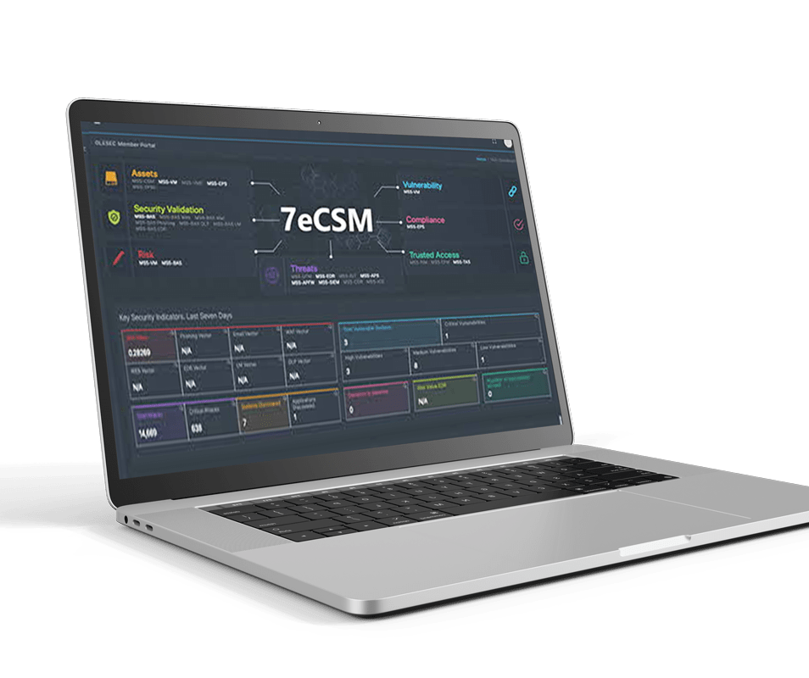
DEMO
SKYWATCHSM RISK MANAGEMENT AND CYBERSECURITY PLATFORM

Slide 14
Table of Services, GTP and Homologated Vendors
SERVICE | GTP | Homologated Vendor
MSS-TAS | DUO SECURITY | none
MSS-VME | TENABLE; BURP SUITE | none
MSS-VM | TENABLE | none
MSS-BAS | CYMULATE | none
MSS-WAF; MSS-WAF-CLOUD | RADWARE | none
MSS-DDOS; MSS-DDOS-CLOUD | RADWARE | none
MSS-UTM | PALO ALTO | Candidates: CHECK POINT; FORTINET; CISCO
MSS-EDR | CYNET | Candidates: CROWD STRIKE; CARBON BLACK; MICROSOFT APT
MSS-DLP | ITSMINE | none
MSS-CSME; MSS-CSM | PAESSLER | none
MSS-SIEM; MSS-SOAR | SPLUNK | none
MSS-TPV | BITSIGHT | none
MSS-EPCM | PROMISEC | none
MSS-INT-DW | CYBERSIXGILL | none
MSS-BRAND | BRANDSHIELD | none

Slide 15
SKYWATCHSM RISK MANAGEMENT PLATFORM SCOPE
SKYWARCH Service Family | SKYWATCH Services Included | Name | What is it?
Skywatch Platform | MSS-CSO | Skywatch Platform | Risk Management, Security and Compliance unified platform. Process oriented. Consolidates all information on a single platform. Translation of information for Executives and Technical people.
External Attack Surface Management | MSS-VME | External Vulnerabilty Management | External assets baselining, discovery, monitoring; external vulnerability handling as a lifecycle process.
 | ESA | External Security Assessment and Pentest | External vulnerability testing and remediation support
 | MSS-BAS Immediate Threat | Breach & Attack Validation of Immediate Threats | Immediate testing of newly found vulnerabilities and remediation handling.
 | MSS-BAS Email | Email Controls Validation | Lifecycle testing of security controls for email with remediation handling.
 | MSS-BAS Browser | Browser Controls Validation | Lifecycle testing of security controls to access files while navigating the Internet with remediation handling.
 | MSS-BAS WAF | WAF Controls Validation | Lifecycle testing of security controls of the Internet facing servers with remediation handling.
 | MSS-INT-DW | Threat Intelligence from DarkWeb | Threat hunting on the dark web for information related to the assets of the organization
 | MSS-BRAND | Brand Monitoring and Takedown | Brand monitoring and take-down
 | MSS-EDR | Endpoint Security | Detection of suspicious and/or malicious activity in the endpoints; response in real-time to threats - perimeter systems
 | MSS-GAP | Compliance GAP Analysis automation | GAP analysis for multi-standards in real-time with remediation support
 | MSS-TPV | Supply Chain Risk Monitoring | Security scoring of third-party organizations and detailed external view of security
 | MSS-EPM | Patch Management | Patch management service for external systems
 | MSS-TAS | Multifactor Authentication | Multi-factor authentication service
 | MSS-CSM | System Availability and Performance Monitoring | Monitoring of availability and performance of external systems
 | MSS-UTM | UTM Security | Monitoring and response to information from the firewalls. Change Management.
 | MSS-WAF | WAF Protection | Detection and protection of attacks to Internet facing web servers
 | MSS-DDoS | DDoS Protection | Detection and protection of intrusions and denial of service attacks.
Internal Attack Surface Management | MSS-VMI | Internal Vulnerability Management | Internal assets baselining, discovery, monitoring; internal vulnerability handling as a lifecycle process.
 | MSS-BAS DLP | DLP Controls Validation | Lifecycle testing of security controls to data exfiltration with remediation handling.
 | ISA | Internal Security Assessment and Pentest | Internal vulnerability testing and remediation support
 | MSS-BAS EDR | Endpoint Controls Validation | Lifecycle testing of security controls to endpoint protection with remediation handling.
 | MSS-EDR | Endpoint Security | Detection of suspicious and/or malicious activity in the endpoints; response in real-time to threats
 | MSS-EPM | Patch Management | Patch management service
 | MSS-TAS | Multifactor Authentication | Multi-factor authentication service
 | MSS-SIEM | Managed SIEM | Service to capture information from various sources to provide visibility, detection and response
 | MSS-PBA | Managed SOAR | Service to automate actions for efficient response in multi-platform environment at the client
 | MSS-BAS Phishing | User awareness validation | Determination of the level of awareness of internal personnel
 | MSS-CSM | System Availability and Performance Monitoring | Monitoring of availability and performance of all systems
 | MSS-IAM | Identity and Access Management
 | MSS-EPCM | Endpoint Configuration Management | Baseling of configuration management and detection of gaps with remediation support
 | MSS-DLP | Data Loss Prevention and Protection | Monitoring of attempts to exfiltrate data; protection against data leakage. On-going improvement of the awareness of internal personnel in handling of confidential documents.
 | MSS-USB | USB Management | Detection and protection of files in USB drives.
Cyber Range Training | Cyber-Range |  | SOC and Red Team training on Cyber Range Platform

Slide 16





GLESEC AT A GLANCE
Self-performed
FOUNDED
CLIENTS
work
2003 in New Jersey
Adaptive Managed Security Services
Risk Management
Banking Institutions
Airlines
Healthcare Organizations
Educational Institutions
Compliance
Security Professional Services
Governments
Technology
Personnel
Partners
15
OF THE TOP
20
30
2
Emerging technology companies in the industry
W2’S
Consultants
SECURED OPERATIONS CENTERS
Orlando, FL, USA
Panama City, Panama

Slide 17
CAPABILITY STATEMENT
PLATFORMS
PROPRIETARY TECHNOLOGY
SOC and NOC
TECHNOLOGY PARTNERS
SKYWATCHSM RISK MANAGEMENT PLATFORM
GLESEC INTRANET PLATFORM
GLESEC MULTI-SECURITY APPLIANCE
INTERNET DATA CENTERS
INTEGRATED WITH MORE THAN 15 INDUSTRY-LEADING TECHNOLOGIES
7-ELEMENTS OF CYBERSECURITY Framework (7eCSM)
RISK MANAGEMENT Platform (SKYWATCHSM)
US SECURED OPERATIONS CENTER
Orlando, Florida
LATAM SECURED OPERATIONS CENTER
- Panama City, Panama
RADWARE
PALO ALTO
SPLUNK
CYMULATE
CYNET
ITSMINE
PAESSLER
BRANDSHIELD
TENABLE
PROMISEC
IVANTI
DUO SECURITY
CYBER ARK
DATALOCKER
CYMPIRE
SKYWATCHSM integrates natively to the GLESEC Technology Partners and homologates with many other products.

Slide 18
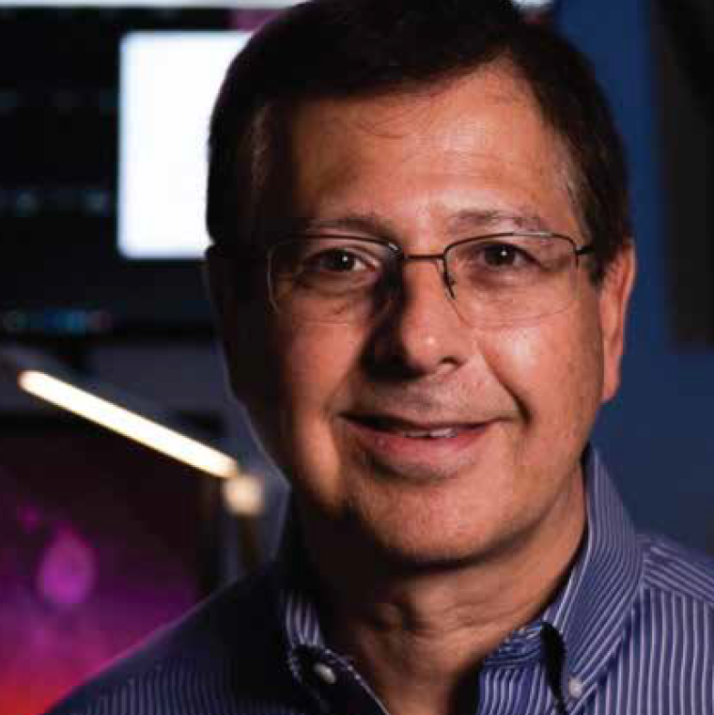
Sergio Heker
A PIONEER OF THE INTERNET AND CYBERSECURITY
Cybersecurity
Leader
Technologist
Academic
A regular conference speaker and widely recognized as a founding father of outsourced cybersecurity services.
Founding member of the Internet Society and co-developer of established Internet Protocol standards.
Research Associate of the University of Central Florida. BSc. & MSc. Electrical Engineering
Member of UCF School of Engineering Advisory Board

Slide 19
Thank you!
USA
WORLDWIDE HEADQUARTERS​
PANAMA
LATIN AMERICAN HEADQUARTERS
+1 (321) 430-0500
info@glesec.com
+507 836-5355
info@glesec.com

